Slide 1
Low Level Design (LLD)
Part 1

Slide 2

What is LLD?
Component Level Design Process
Provides internal logic of software being developed
Defines the class diagram that has attributes and methods, defining relationships between them, etc.

Slide 3
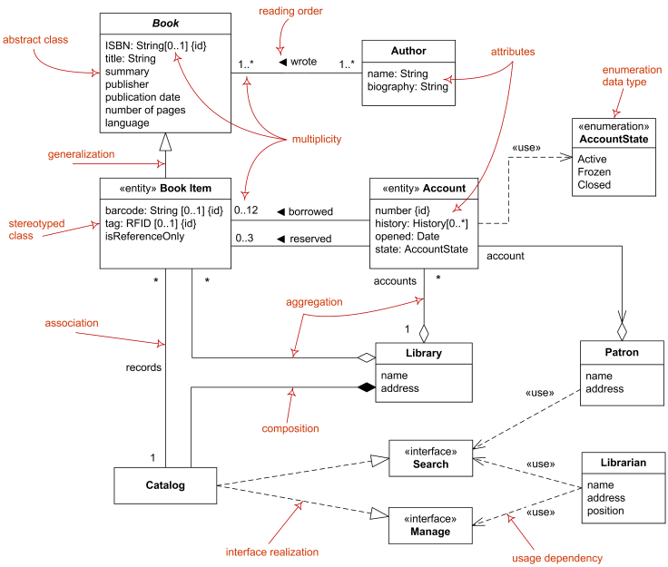


Slide 4
Fundamentals of LLD

Slide 5
Fundamentals of LLD
OOP
Object-Oriented Programming

Slide 6
Course Structure
Week 1 | Foundational OOP
Week 2 | Practical OOP
Week 3 | Advance Concepts of OOP
Week 4 | LLD Basic Principles
Week 5 | Design Patterns
Week 6 | How to approach LLD problems?
Week 7 | LLD FAQs
Week 8 | LLD FAQs

Slide 7
What is OOP?
Object-Oriented Programming (OOP) is a fundamental concept in software development that revolves around the concept of Classes and Objects.

Slide 8
Classes and Objects
int main() {
int a;
....
return 0;
}

Slide 9
Classes and Objects
32-bit integer value
int main() {
int a;
....
return 0;
}

Slide 10
Classes and Objects
class Person { public: int age; string name; string address;
};
int main() { int a; Person p1, p2; .... return 0;
}

Slide 11
Classes and Objects
class Person { public: int age; string name; string address;
};
int main() { int a; Person p1, p2; .... return 0;
}
Custom defined.

Slide 12
Classes and Objects
class Person { public: int age; string name; string address;
};
int main() { int a; Person p1, p2; .... return 0;
}
Custom defined.
Non-primitive data-type

Slide 13

Classes and Objects
class Person { public: int age; string name; string address;
};
int main() { int a; Person p1, p2; .... return 0;
}
Custom defined.
Non-primitive data-type
Objects

Slide 14
Classes and Objects
class Person { public: int GetName() { return name; } void SetName(string name) { name_ = name; } ... private: int age_; string name_; string address_;
};
int main() { Person p1; p1.SetName(“abc”); cout << p1.GetName(); return 0; }

Slide 15
Classes and Objects
class Person { public: int GetName() { return name; } void SetName(string name) { name_ = name; } ... private: int age_; string name_; string address_;
};
int main() { Person p1; p1.SetName(“abc”); cout << p1.GetName(); return 0; }
Class members are accessed by (.) operator

Slide 16

Classes and Objects
class Person { public: int GetName() { return name; } void SetName(string name) { name_ = name; } ... private: int age_; string name_; string address_;
};
int main() { Person p1; p1.SetName(“abc”); cout << p1.GetName(); p1.age_ = 25; return 0; }

Slide 17
Classes and Objects
class Person { public: int GetName() { return name; } void SetName(string name) { name_ = name; } ... private: int age_; string name_; string address_;
};
int main() { Person p1; p1.SetName(“abc”); cout << p1.GetName(); p1.age_ = 25; return 0; }
Won’t compile

Slide 18
Classes and Objects
The public members of a class can be accessed from anywhere in the program using the direct member access operator (.) with the object of that class.
class Person { public: int GetName() { return name; } void SetName(string name) { name_ = name; } ... private: int age_; string name_; string address_;
};
int main() { Person p1; p1.SetName(“abc”); cout << p1.GetName(); p1.age_ = 25; return 0; }
Won’t compile

Slide 19
Classes and Objects
The public members of a class can be accessed from anywhere in the program using the direct member access operator (.) with the object of that class.
class Person { public: int GetName() { return name; } void SetName(string name) { name_ = name; } ... private: int age_; string name_; string address_;
};
int main() { Person p1; p1.SetName(“abc”); cout << p1.GetName(); p1.age_ = 25; return 0; }
can be accessed here
Won’t compile
The private members are not accessible outside the class; they can be accessed only through member functions of the class.

Slide 20
Class Initialization

Slide 21
Class Initialization
Constructors
A constructor is a special member function that is automatically called after a object is created.
class Person { public: Person(int age, string name, string address) { age_ = age; name_ = name; address_ = address; } ... private: int age_; string name_; string address_;
};
Constructor

Slide 22
Class Initialization
Constructors
Unlike normal member functions, constructors have specific rules for how they must be named:
Constructors must have the same name as the class (with the same capitalization).
Constructors have no return type (not even void).

Slide 23
Concepts Check-in
LLD Overview
Classes and Objects
Public & Private members
Constructors
Getter & Setter Pattern

Slide 24
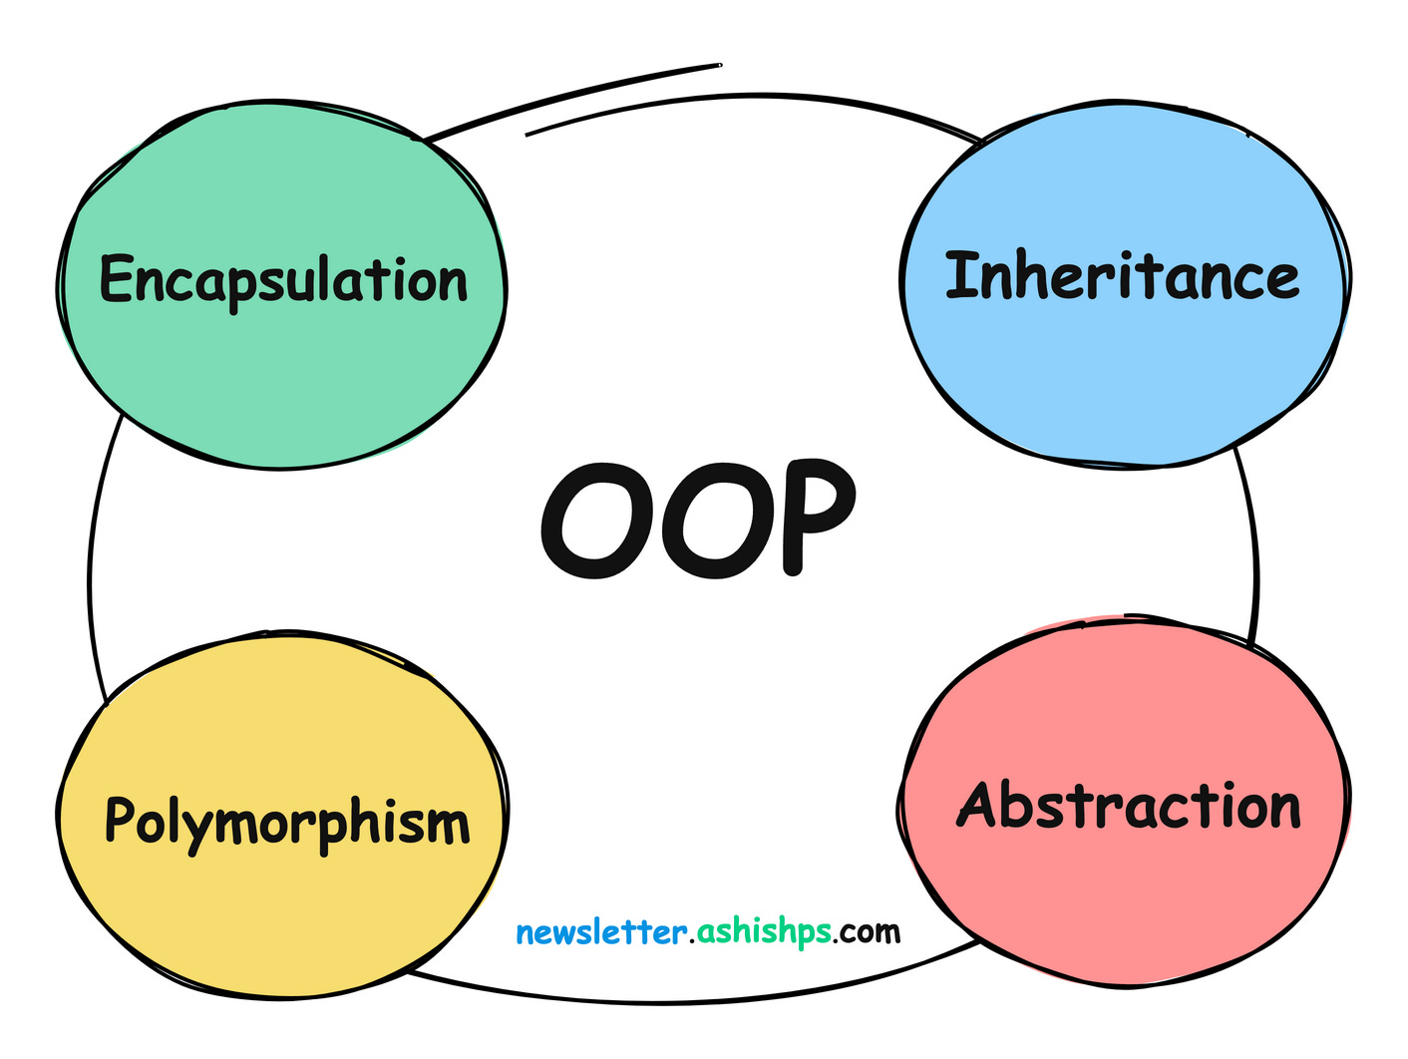

Slide 25
Encapsulation
Encapsulation is the integration of data and operations into a class.
Encapsulation is hiding the functional details from the object calling it.

Slide 26

Encapsulation
Encapsulation is the integration of data and operations into a class.
Encapsulation is hiding the functional details from the object calling it.

Slide 27
Encapsulation
class Car { public: void Clutch(); void Break(); void Accelerate(); private: Engine engine_; .... };
Exposed to the user
Hidden from the user

Slide 28
Inheritance
Inheritance is a mechanism in which one object acquires all the properties and behaviors of a parent object.
Inheritance represents IS-A relationship.
E.g. Employee is a Person, Engineer is a Employee, etc.

Slide 29





Inheritance
class Employee : public Person {
public: string job_role;
string company;
int salary; int id;
};
class Person {
public: int age; string name; string address;
string mobile_no; string aadhaar_no;
};
class SoftwareEngineer : public Employee {
public: string team; string tech_stack; string language_expertise; int level;
};

Slide 30
Inheritance
class SoftwareEngineer {
public: string team; string tech_stack; string language_expertise; int level;
string job_role;
string company;
int salary; int id;
int age; string name; string address;
string mobile_no; string aadhaar_no;
};

Slide 31
What’s next?
Polymorphism
Abstraction

Slide 32
Thank You!

